Slide 1
AI BASED FIRE EXTINGUISHING ROBOT
GROUP MEMBERS-
SWAPNIL VERNEKAR
SUMAN SHREYAS
RISHABH JHA
SANDHYARANI THATIPAMULA

Slide 2
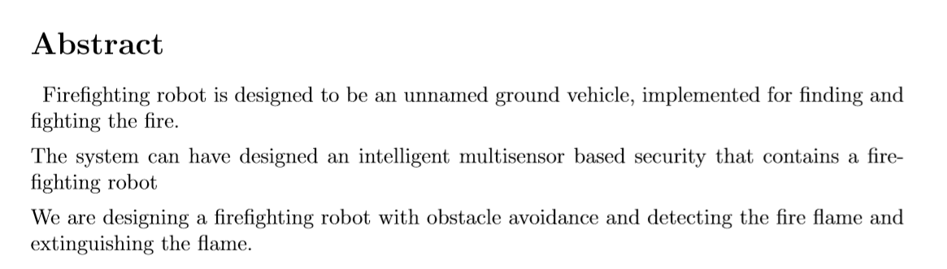

Slide 3
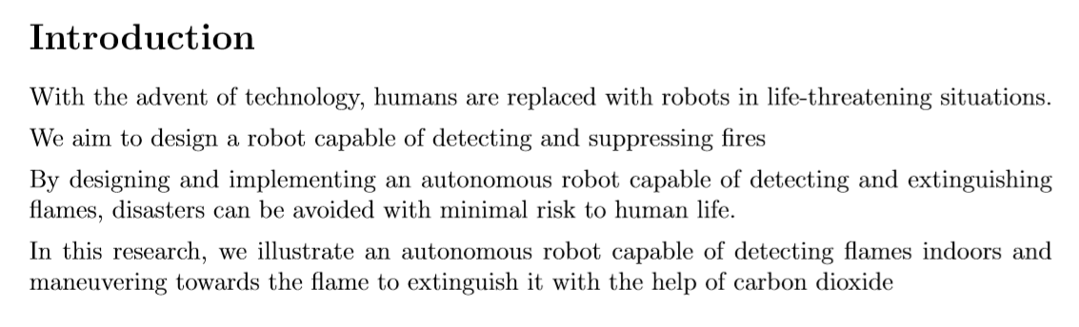

Slide 4
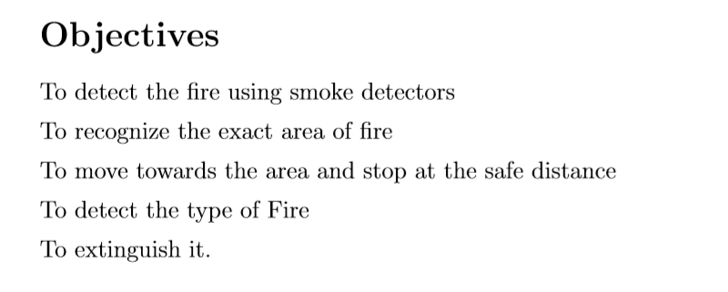

Slide 5
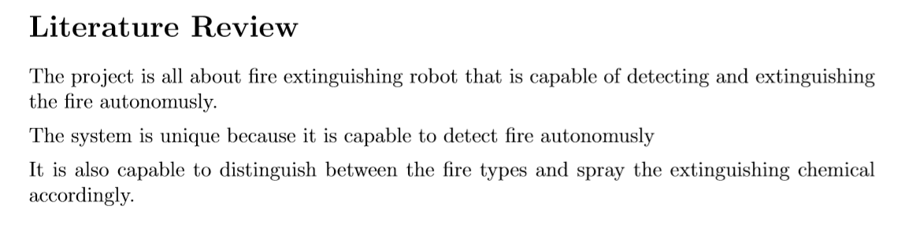

Slide 6
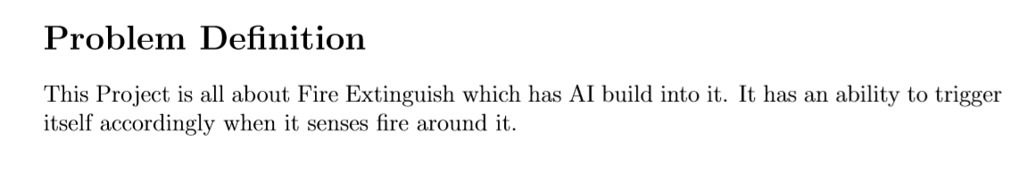

Slide 7
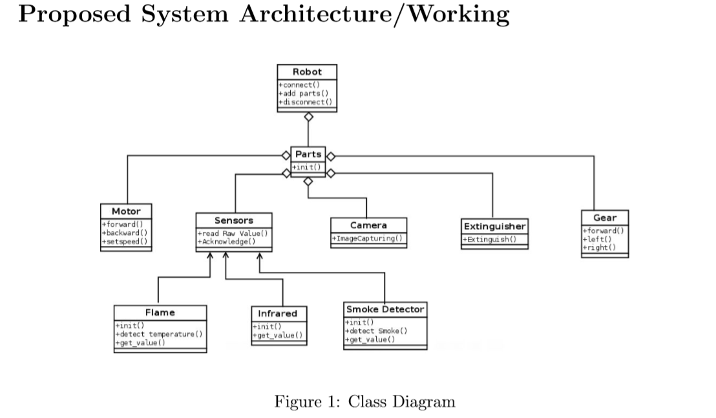

Slide 8
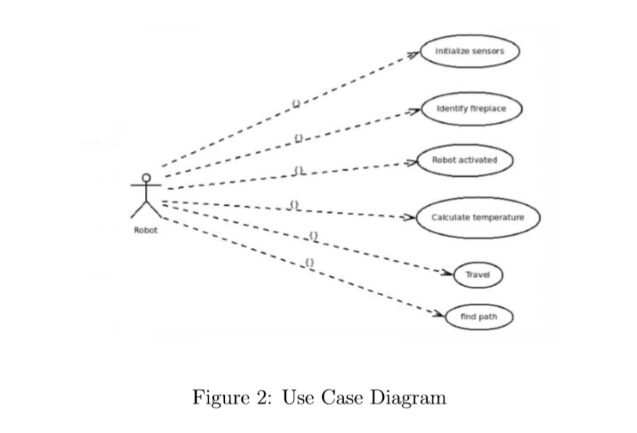

Slide 9
